Slide 1


Caleb Pillay
16/01/2023

Slide 2

Outline
Executive Summary
Introduction
Methodology
Results
Conclusion
Appendix

Slide 3
Executive Summary
Summary of methodologies
Data collection with web scrapping
Data wrangling with pandas library
Data exploration with SQL IBM DB2 database and pandas library
Data visualization Matplotlib library
Data plotting with Folium library
Data mining with Plotly and Dash library
Machine learning with Scikit-learn library
Summary of all results
SQL table outputs
Graphs and an interactive dashboard
Predicative machine algorithms

Slide 4
Introduction
Project background and context
SpaceX advertises Falcon 9 rocket launches on its website with a cost of 62 million dollars; other providers cost upwards of 165 million dollars each, much of the savings is because SpaceX can reuse the first stage. Therefore, if we can determine if the first stage will land, we can determine the cost of a launch.
Problems you want to find answers
Determine if the first stage of Falcon 9 will land.
Determine if there are existing variables that affect landing success rate.

Slide 5

Section 1

Slide 6
Methodology
Executive Summary
Data collection methodology:
Web scraped data from the Wikipedia page: List of Falcon 9 and Falcon Heavy launches using Requests and Beautiful Soup library
Perform data wrangling
Data was cleaned in a Pandas data frame using python
Perform exploratory data analysis (EDA) using visualization and SQL
Perform interactive visual analytics using Folium and Plotly Dash
Perform predictive analysis using classification models
Models were built with Scikit-learn using the iterative process of grid search

Slide 7
Data Collection
The data was web scrapped and entered into a data frame
Using the requests library in python a request was made to the Wikipedia server, data was recorded and stored in static-url format, using the ‘static_url’ decorator.
A beautifulsoup object was created using the ‘html.parser’ decorator.
An empty dictionary assigned with keys from the extracted column names from the beautifulsoup object.
A predefined function was created to extract and assign the table contents from the beautifulsoup object into a dictionary object.
A predefined function was created to extract the dictionary values and assign them into a data frame.

Slide 8
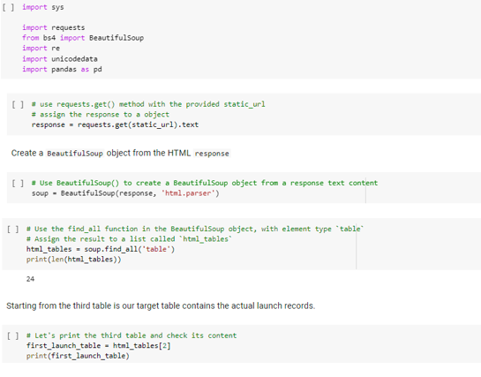
Data Collection - Scraping
Web scraped data from the Wikipedia page: List of Falcon 9 and Falcon Heavy launches using Requests and Beautiful Soup library
Coursera/blob/main/Webscraping_SpaceX.ipynb
Place your flowchart of web scraping here

Slide 9
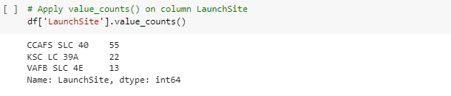
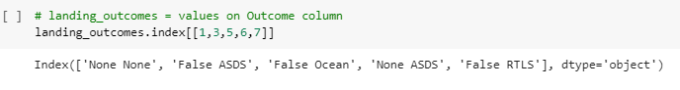
Data Wrangling
Exploratory Data Analysis was applied to find patterns in the data
Pandas data frame was used for ease of functionality
Launch sites were identified
Landing outcomes were relabeled to success – ‘1’ or not – ‘0’ for model use
Coursera/blob/main/Data_wrangling_Spacex.ipynb

Slide 10
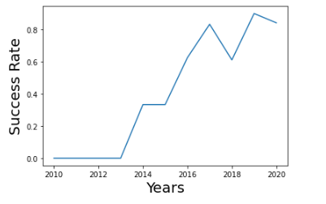
EDA with Data Visualization
Matplotlib and Seaborn plotting libraries were used
Relationships between payload-mass, flight number, launch site, orbit were plotted to visually assess the launch success rates.
Interestingly : Launch success rate saw a sharp increase from 2013 onward
Coursera/blob/main/EDA-DATAVIZ-SpaceX.ipynb

Slide 11
EDA with SQL
Coursera/blob/main/EDA-SQL-SpaceX.ipynb
The data frame was inserted in the IBM’s cloud faculty DB2
Queries were performed in a Jupyter notebook using a db2 connection string
SQL-Alchemy library allowed for sql queries to be performed
Identified launch sites
Total payload mass launched from individual sites and booster versions
Date of first successful landing on a ground pad.
Boosters which have successful landing on drone ship and payload mass between 4000 – 6000.
Total outcomes of launches.
Landing outcomes between various dates.

Slide 12
Build an Interactive Map with Folium
Coursera/blob/main/Folium-SpaceX.ipynb
Folium library was used to plot launch sites and individual launches onto a map
A visual representation of successful lunches at each site was created
Visually investing if there are any proximity variables that could affect a launches success rate
The questions posed were:
Do proximities to cities affect a launched success?
Do proximities to railways, highways and coastlines affect a launched success?

Slide 13
Build a Dashboard with Plotly Dash
Effectively data mining with Plotly graphs assembled into dashboard using the Dash library
Visually investigated the proportion of successful launches per site using a pie plot
The relationship between successful launches and payload-masses for per site using a scatter plot
Coursera/blob/main/Polty%20dash%20-SpaceX.ipynb

Slide 14
Predictive Analysis (Classification)
Scikit-learn library was used to predict at launch outcome
Models: logistic regression, support vector machine, decision tree classifier and k nearest neighbors
GridSearchCV was used to determine the optimal hyperparameters through an iterate process
The best model was chosen by the highest number of correctly predict outcomes from the test data
Coursera/blob/main/Machine_Learning_Prediction_SpaceX_.ipynb

Slide 15
Results
Exploratory data analysis results
Interactive analytics demo in screenshots
Predictive analysis results

Slide 16

Section 2

Slide 17
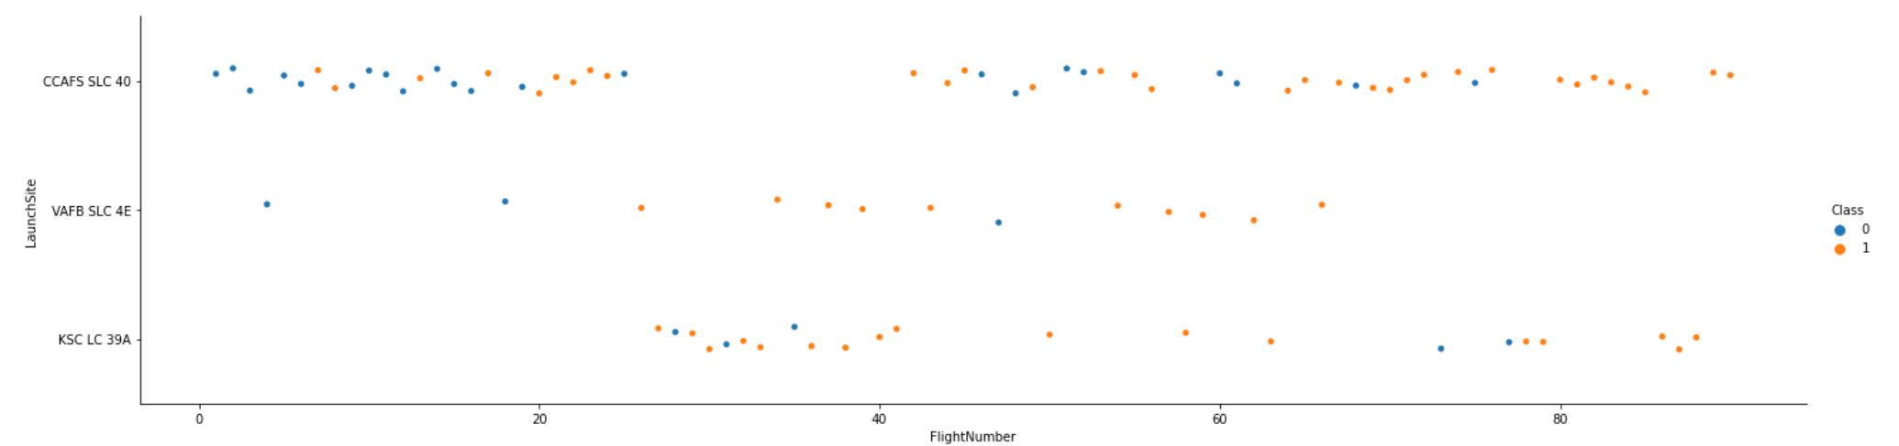
Flight Number vs. Launch Site
CCAFS SLC has the highest number of launches and successful landings

Slide 18
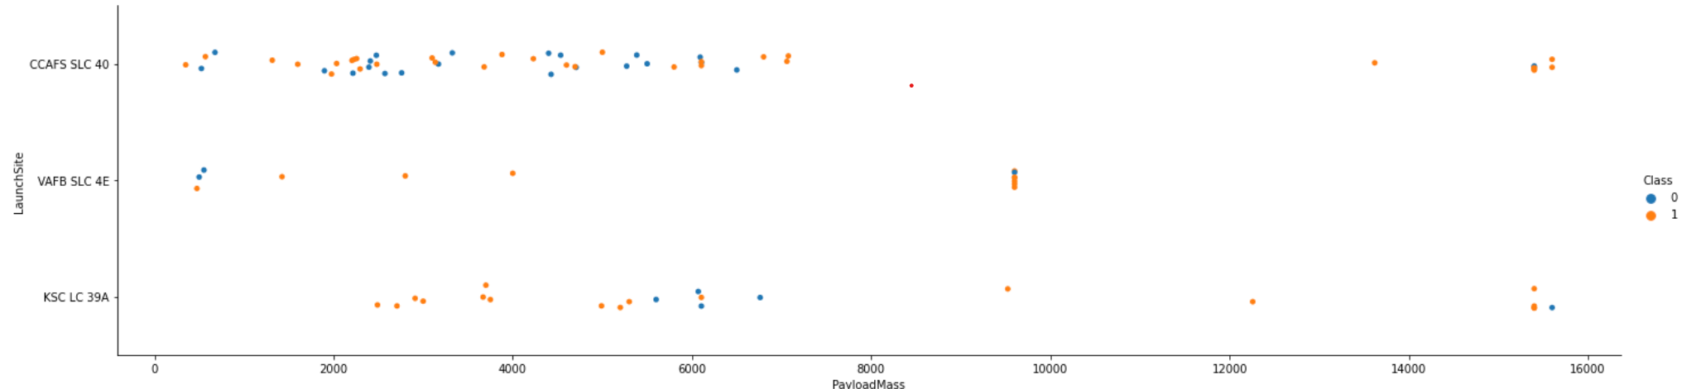
Payload vs. Launch Site
Payloads below 2000kgs has a fewer launches across two sites
Payloads above 8000kgs seems to be more successful at landing across all sites

Slide 19
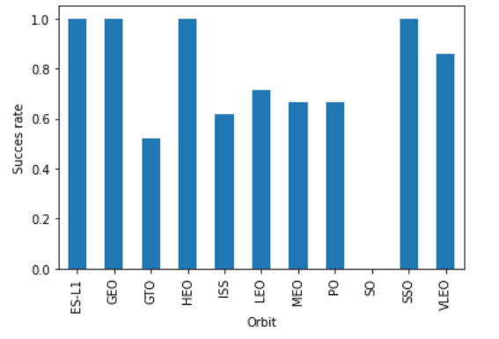
Success Rate vs. Orbit Type
ES-L1, GEO, HEO, SSO, VLEO had the most success rate

Slide 20
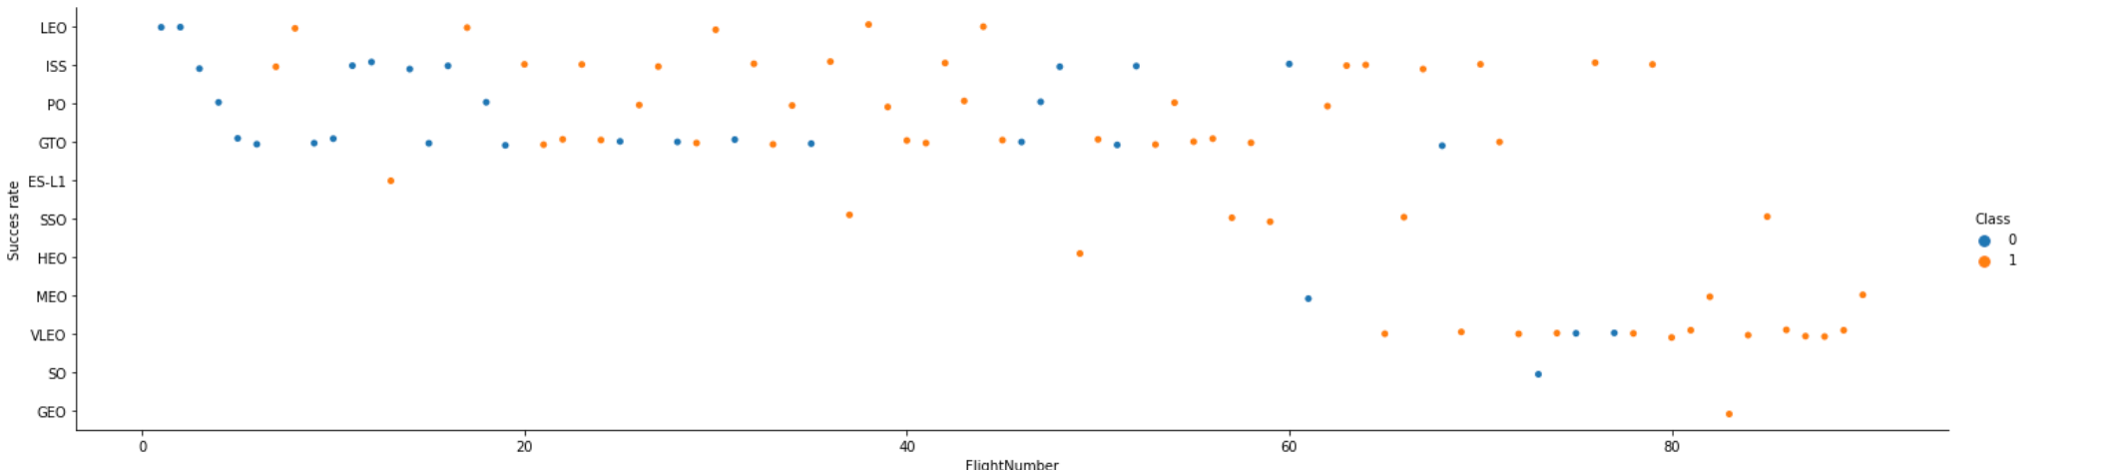
Flight Number vs. Orbit Type
LEO, ISS, PO show an increase in success rate after 20 flights
SSO has a 100% success rate

Slide 21
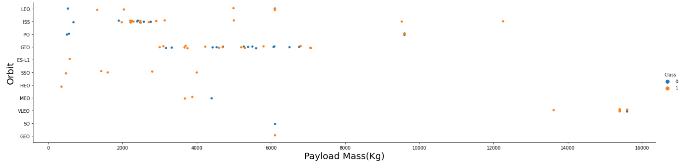
Payload vs. Orbit Type
ISS, ISS & PO have low success rate with payloads below 3000kgs

Slide 22
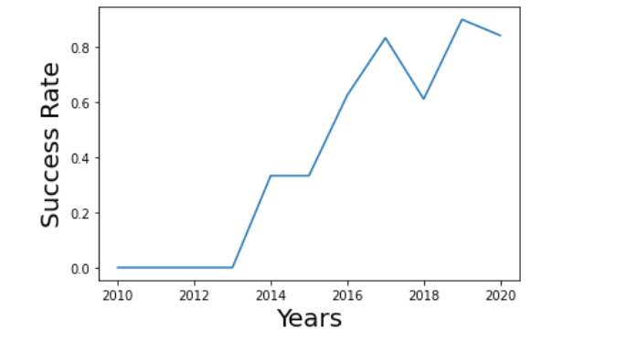
Launch Success Yearly Trend
2013 onward showed a steady increase in success rate of landing

Slide 23
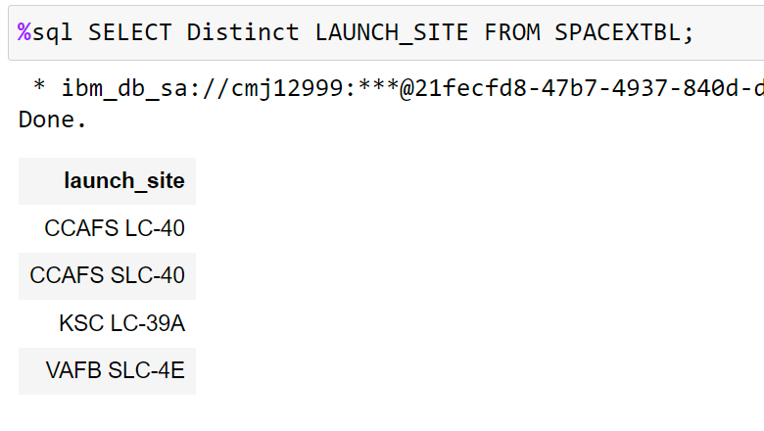
All Launch Site Names
Distinct allowed for the unique categorical variables from launch site to be displayed

Slide 24
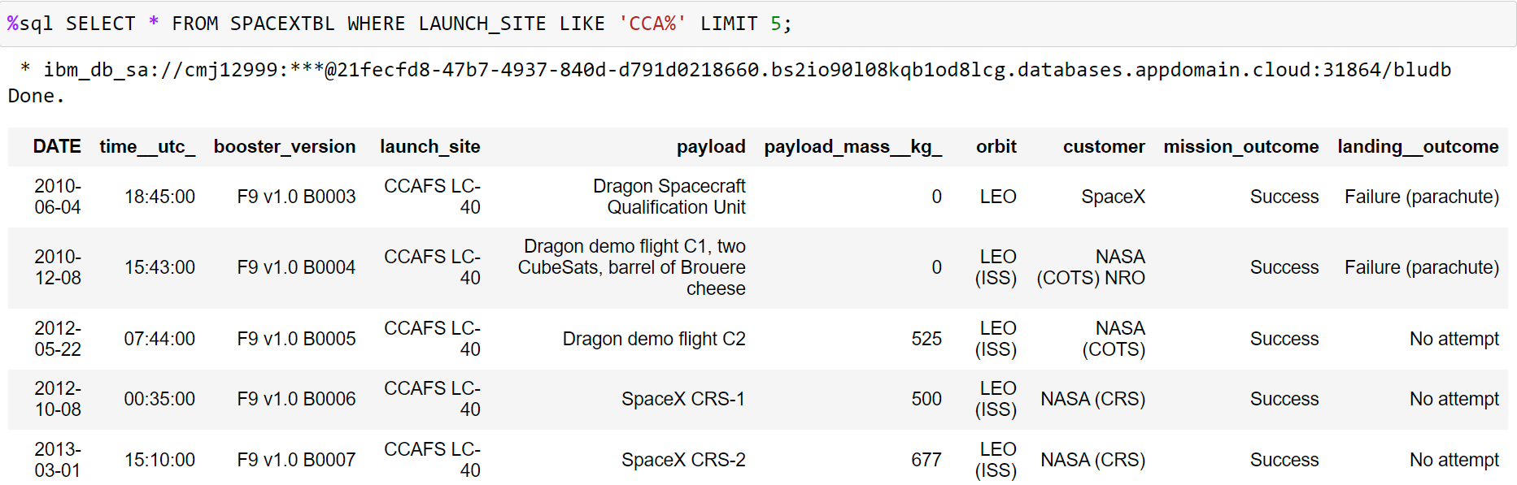
Launch Site Names Begin with 'CCA'
Like clause with wildcat expression “%”, queried all CCA launch sites

Slide 25
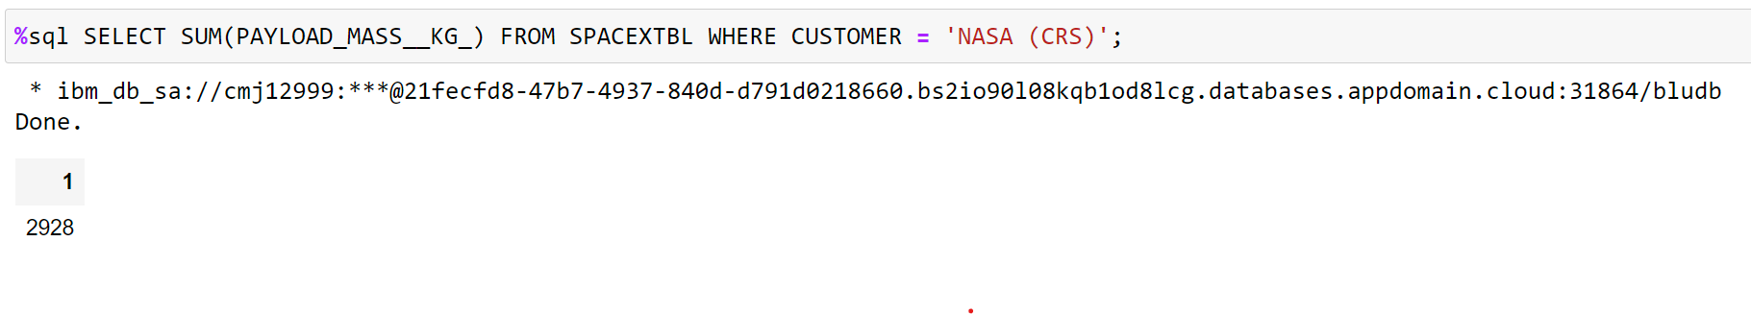
Total Payload Mass
Sum() function calculated the total payload mass of WHERE clause customer “NASA (CRS)”

Slide 26
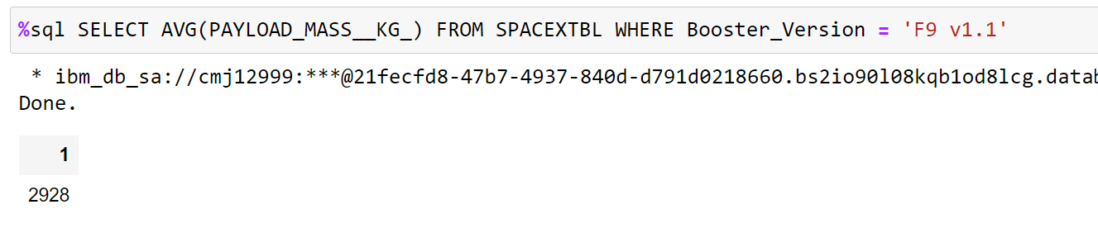
Average Payload Mass by F9 v1.1
AVG() function calculated the average payload mass of WHERE clause booster version is “F9 v1.1”

Slide 27
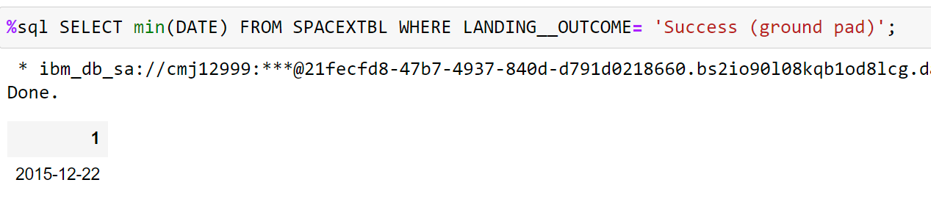
First Successful Ground Landing Date
Min() function was applied to date column to determine the earliest successful ground pad landing

Slide 28
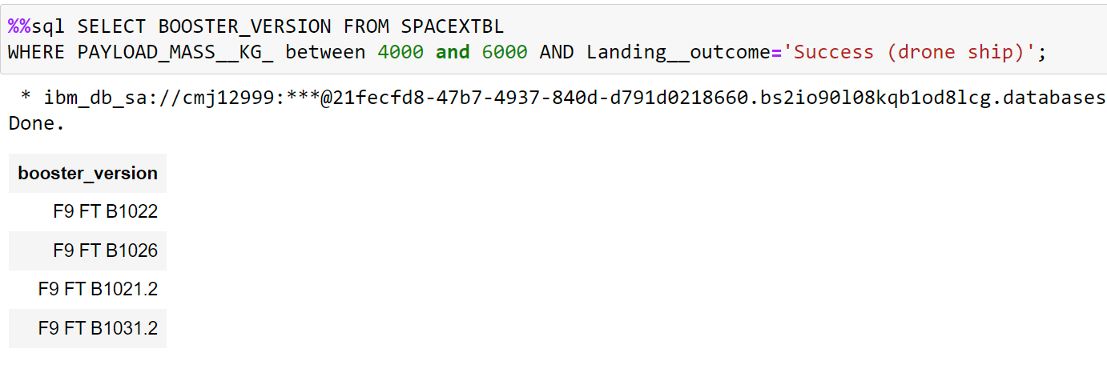
Successful Drone Ship Landing with Payload between 4000 and 6000
Two filters were applied in the WHERE clause, specified payload mass range and landing outcome

Slide 29
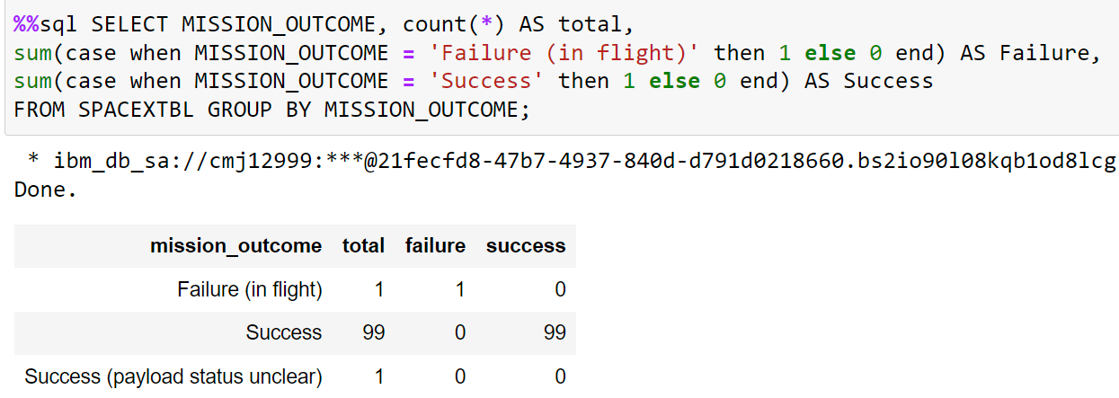
Total Number of Successful and Failure Mission Outcomes
GROUP BY clause allowed for the aggregation of the “Mission Outcome” column

Slide 30
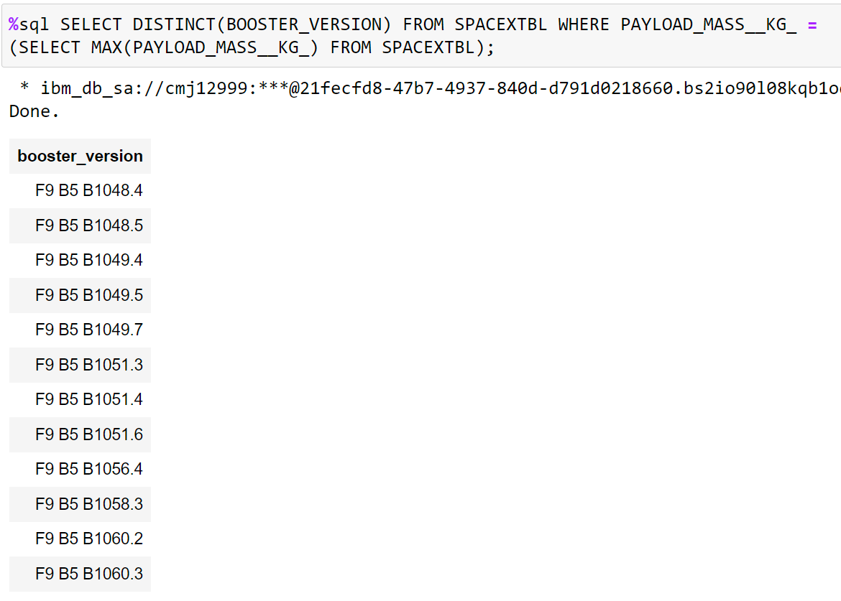
Boosters Carried Maximum Payload
A sub-query was performed in the WHERE clause to filter the for the maximum payload

Slide 31
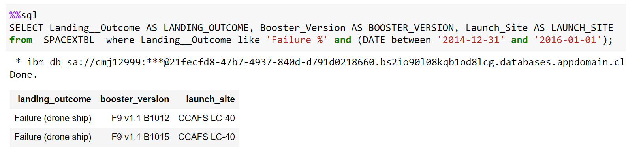
2015 Launch Records
Two filters were used in the WHERE clause a date range and a landing outcome, both had to be satisfied to display a result

Slide 32
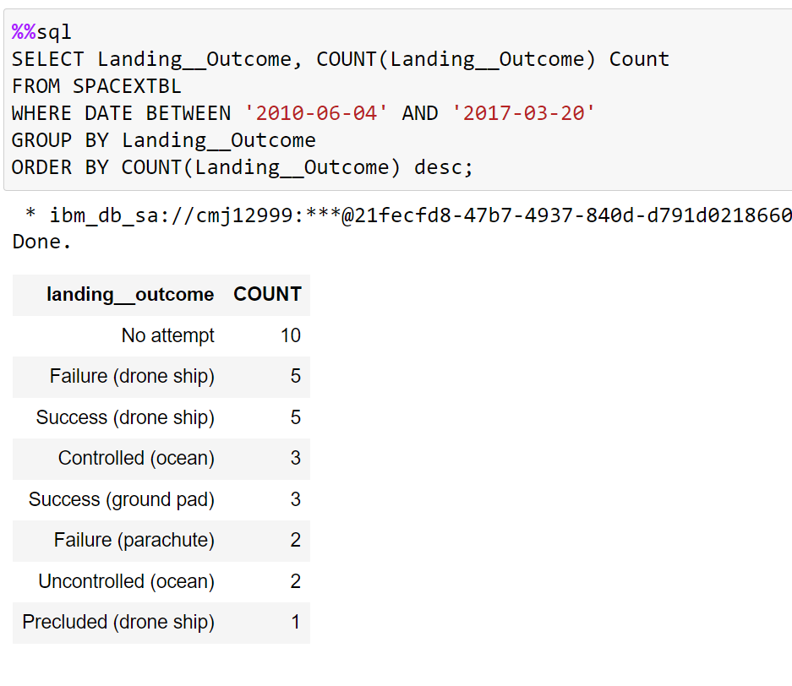
Rank Landing Outcomes Between 2010-06-04 and 2017-03-20
Count() clause numerated the categorical variables in the Landing_Outcome column
Data was aggregated by the Group By clause
Data was ordered by the Order By clause

Slide 33

Section 3

Slide 34
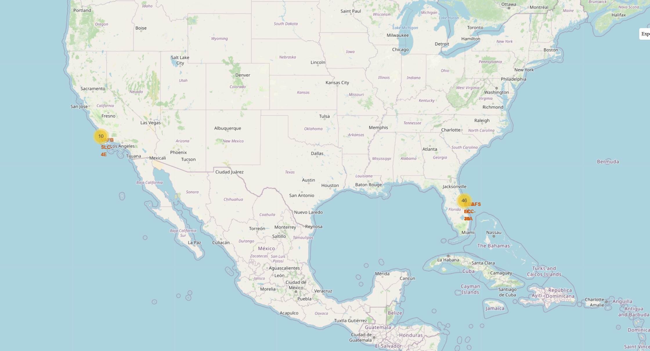
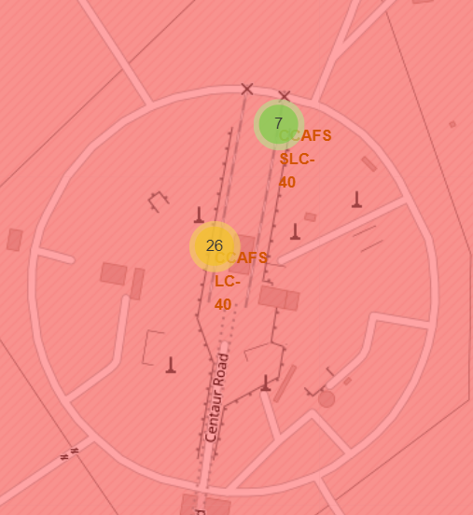
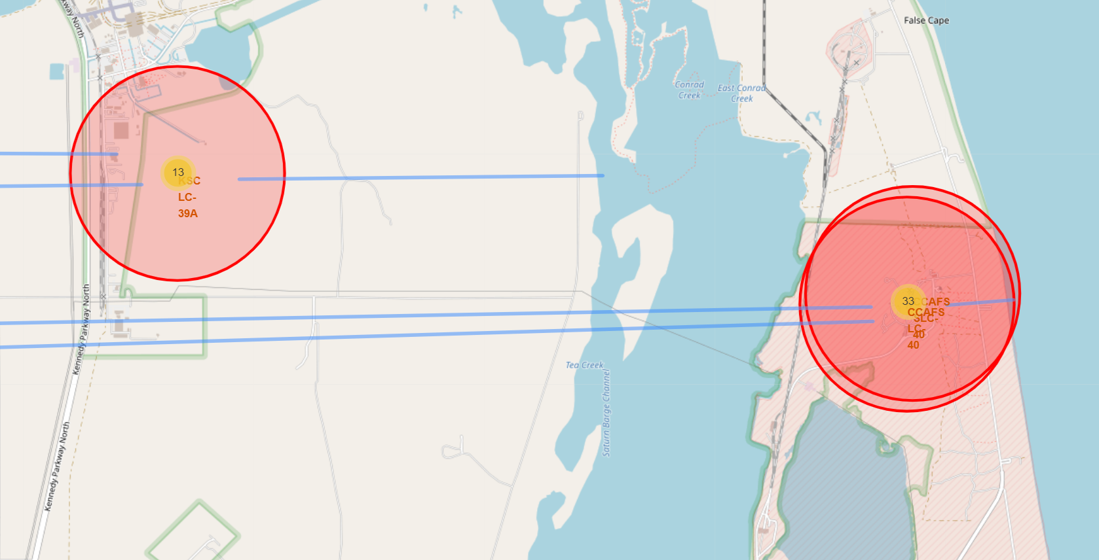
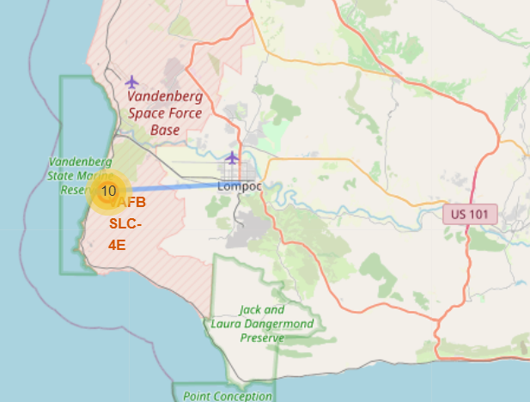
Space X Launch Sites plotted with Folium

Slide 35
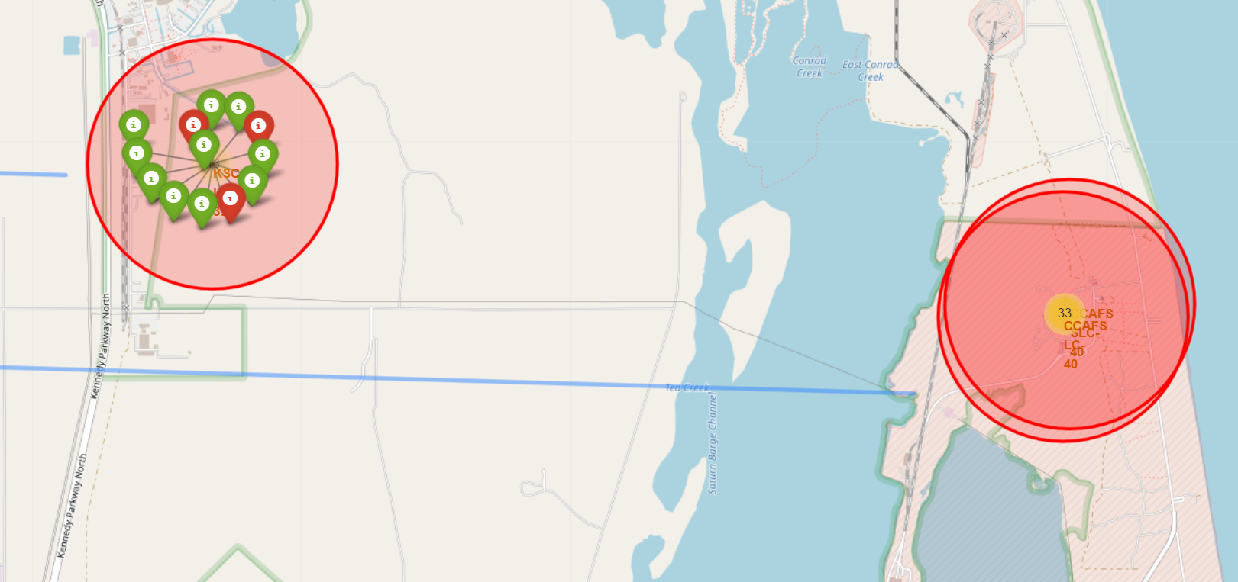
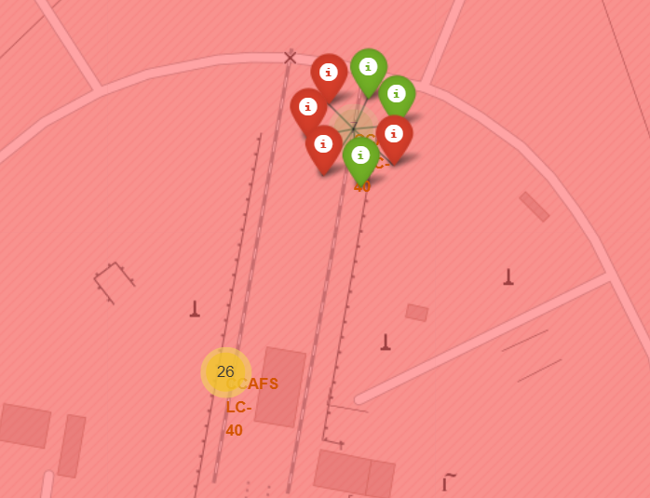
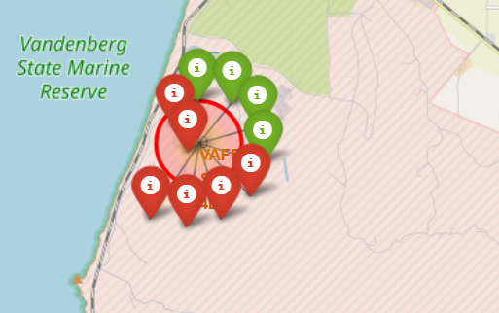
Folium Map Launch Sites
Figure 1
Figure 2
Figure 1: Florida launch sites KSC LC-39A, CCAFS LC-40, CCAFS SLC-40
Figure 2: CCAFS SLC-40 with 7 launches and 3 successful landings
Figure 3: California launch site VAFB SLC-4E, 10 launches and 4 successful landings
Figure 3

Slide 36
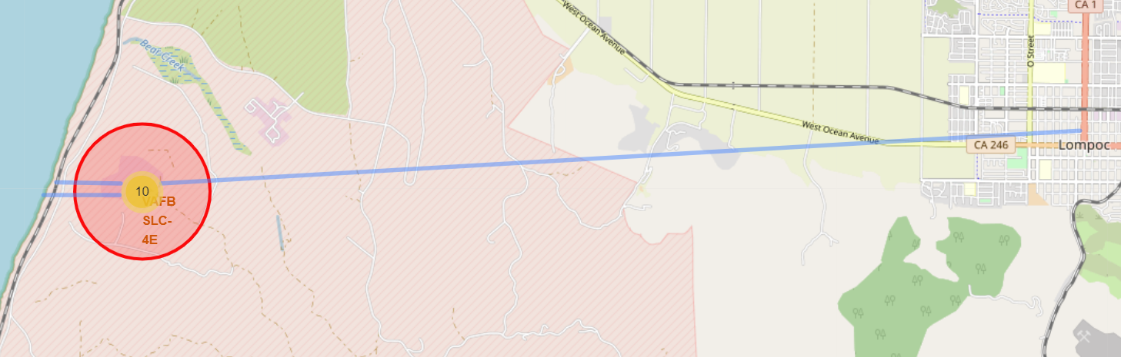
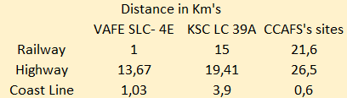
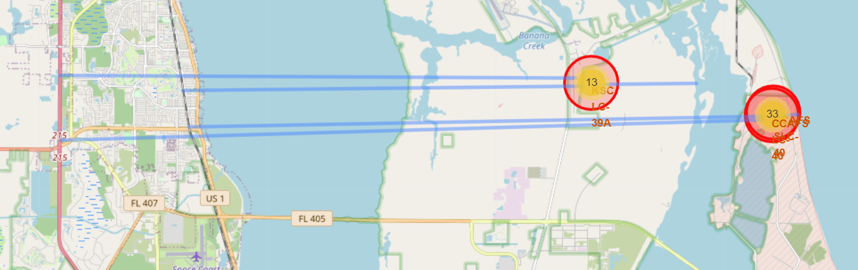
Folium Map Launch Sites Distances to Landmarks
CCAFS sites where grouped into on column above due to the close prolixity to each other
All sites are with 1km from the coast line
Varying distances from the rail-road and greater than 10km from highways
Figure 1: California launch site VAFB SLC-4E
Figure 2: Florida launch sites KSC LC-39A, CCAFS LC-40, CCAFS SLC-40

Slide 37

Section 4

Slide 38
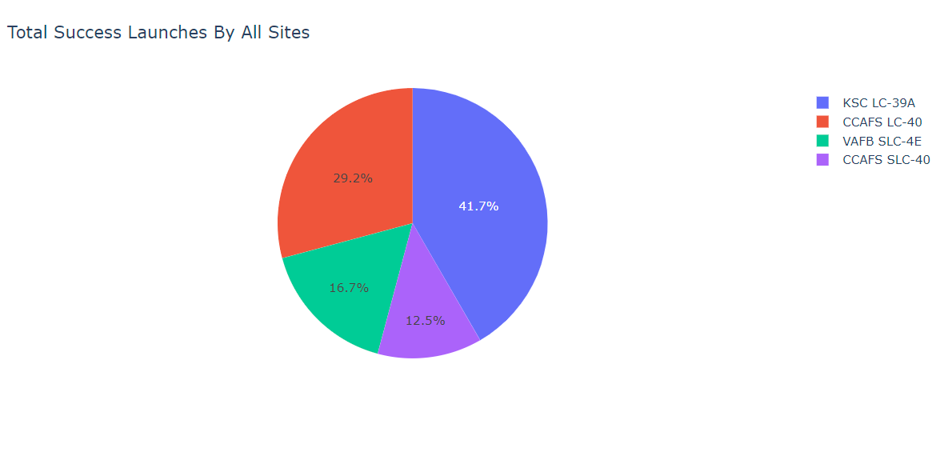
Dashboard Pie Chart of Proportional Launch Site Success
KSC LC 39A had the highest proportion of successful launches of 41,7%
Followed by CCAFS LC-40 with 29,2% successful launches

Slide 39
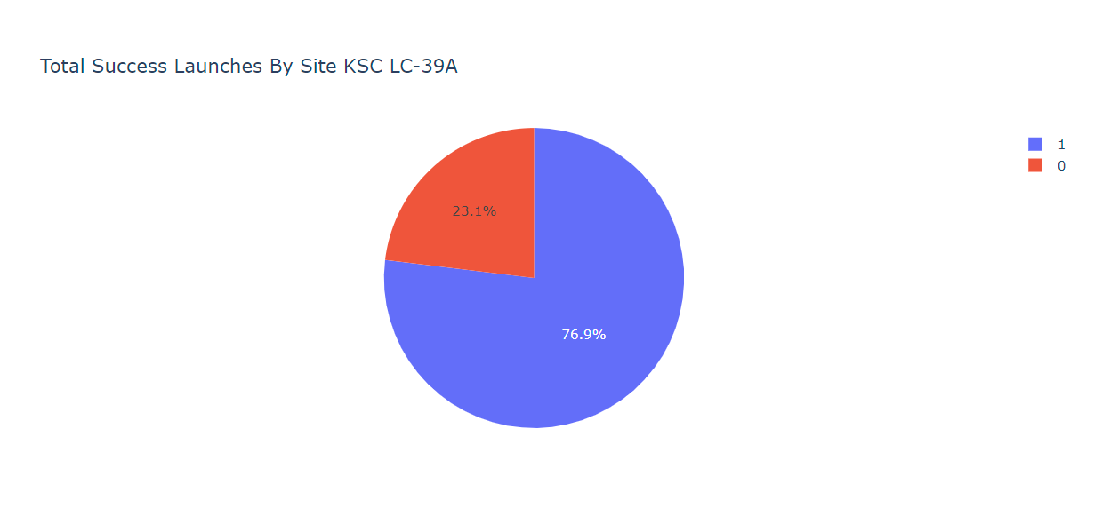
KSC LC 39A Pie Chart of Proportional Launch Site Success
This launch site had the furthest distance (3,9km) from the coast line compared to the other sites which could have attributed to its successful landing percentage

Slide 40
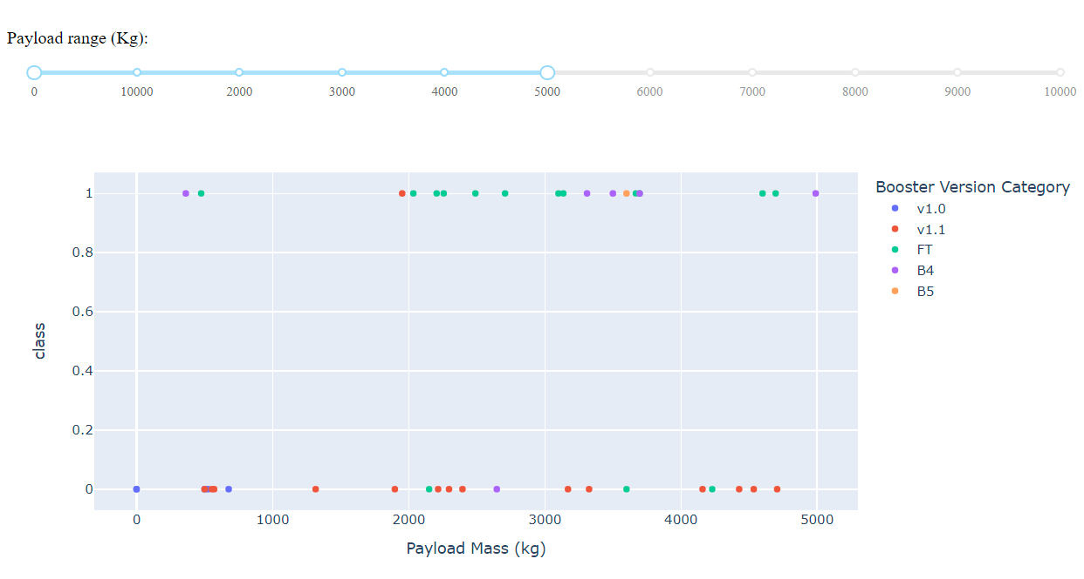
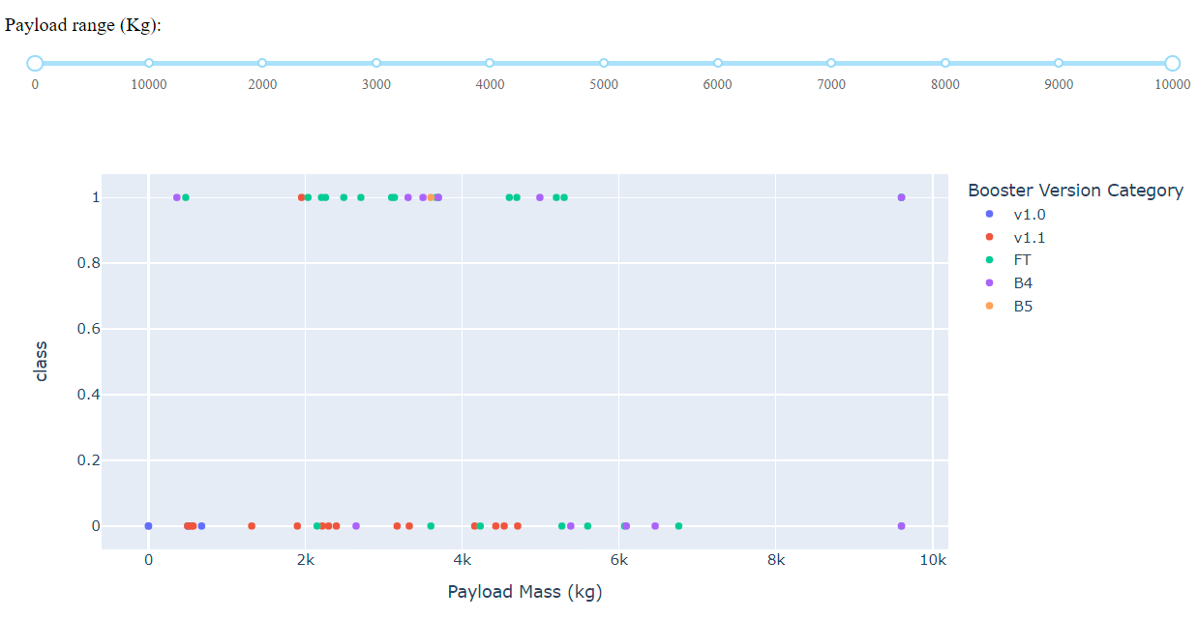
Dashboard Scatter Plot with Payload Range Selector
0 – 5000kg Payloads
0 – 10000kg Payloads

Slide 41

Section 5

Slide 42
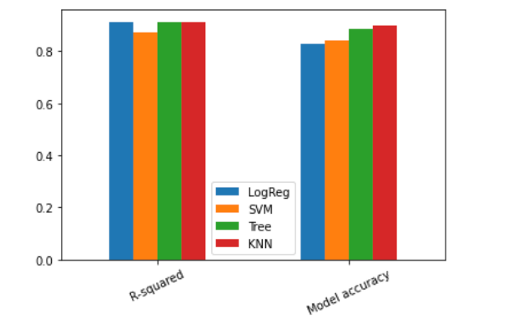
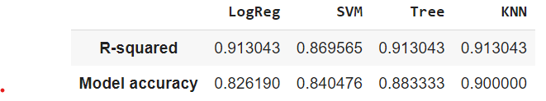
Classification Accuracy
R-squared is the mean measure of cv=10 grid search best parameter
Model accuracy is the r-squared measure of the test data
KNN model performed the best

Slide 43
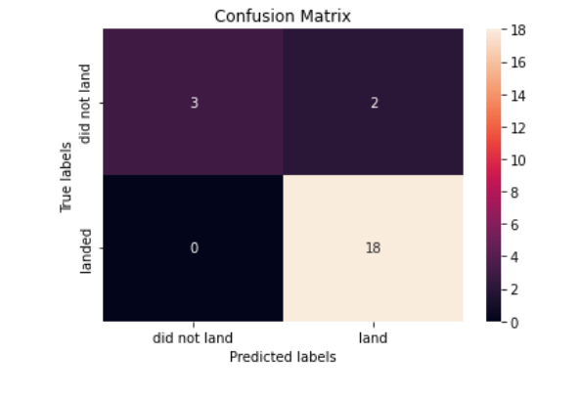
Confusion Matrix
KNN confusion matrix
0 false negatives
2 false positives

Slide 44
Conclusions
KSC LC 39A had the highest successful landing outcomes, which also had the further coastline of 3,9km’s. Coastal wind and humidity could have a role on landing success. This would require further investigation.
Successful landings was seen with payloads between 2000 and 6000kg’s.
Orbits LEO, ISS, PO showed an increase in success rate after 20 flights, and SSO had a 100% success rate.
Launches after 2013 had a greater probability of landing successfully.
KNN algorithm produced the most accurate predictions.

Slide 45


